Slide 1

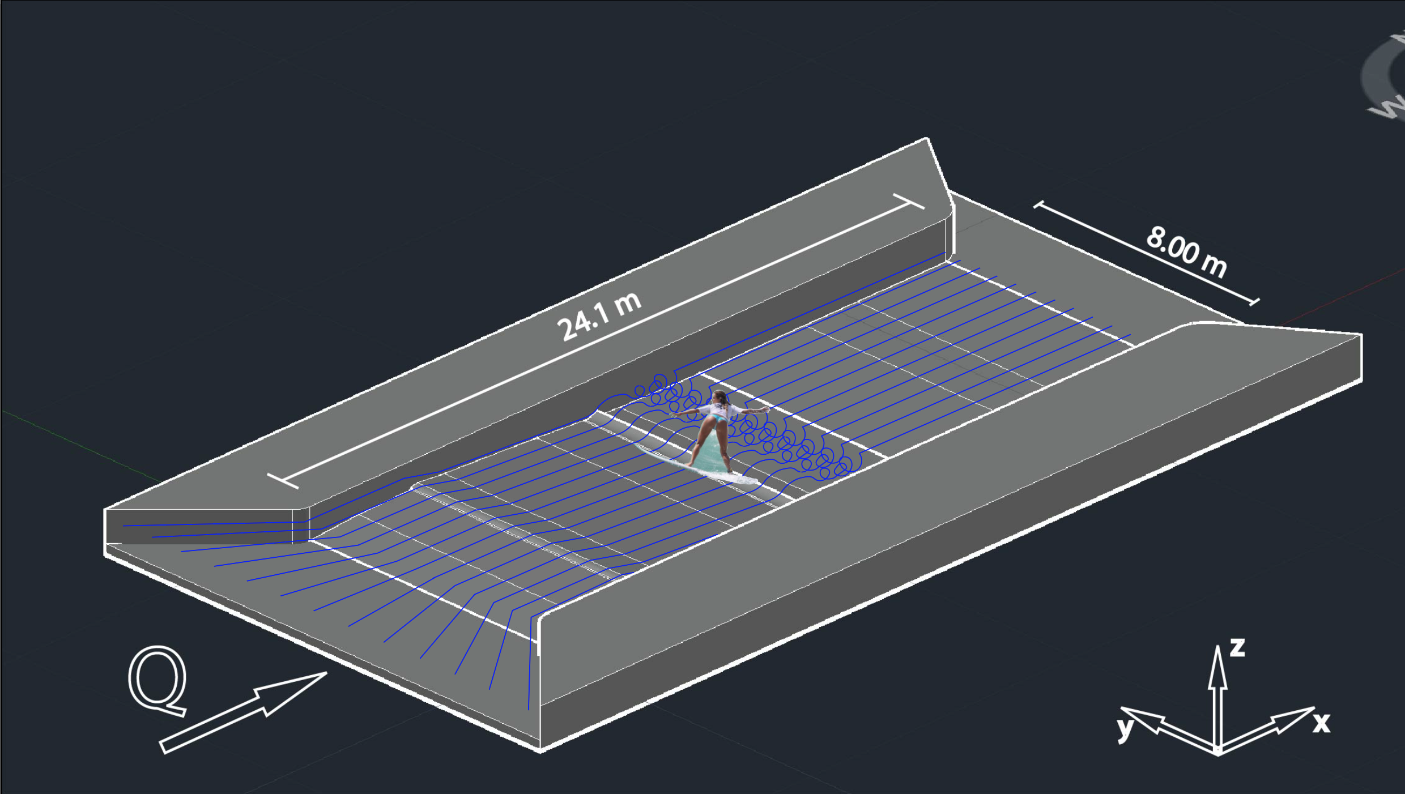
Nikolas Vornehm
Analysis of the Performance of interFoam and shallowFoam Simulating the Steady Wave at the Floßlände
2019, May 8
CFD is Awesome

Slide 2
Content
CFD is Awesome

Slide 3
Content
Floßlände
CFD is Awesome

Slide 4
Content
Floßlände
OpenFOAM – interFoam – shallowFoam
CFD is Awesome

Slide 5
Content
Floßlände
OpenFOAM – interFoam – shallowFoam
Mesh
CFD is Awesome

Slide 6
Content
Floßlände
OpenFOAM – interFoam – shallowFoam
Mesh
3D simulation
CFD is Awesome

Slide 7
Content
Floßlände
OpenFOAM – interFoam – shallowFoam
Mesh
3D simulation
2D simulation
CFD is Awesome

Slide 8
Content
Floßlände
OpenFOAM – interFoam – shallowFoam
Mesh
3D simulation
2D simulation
Results
CFD is Awesome

Slide 9
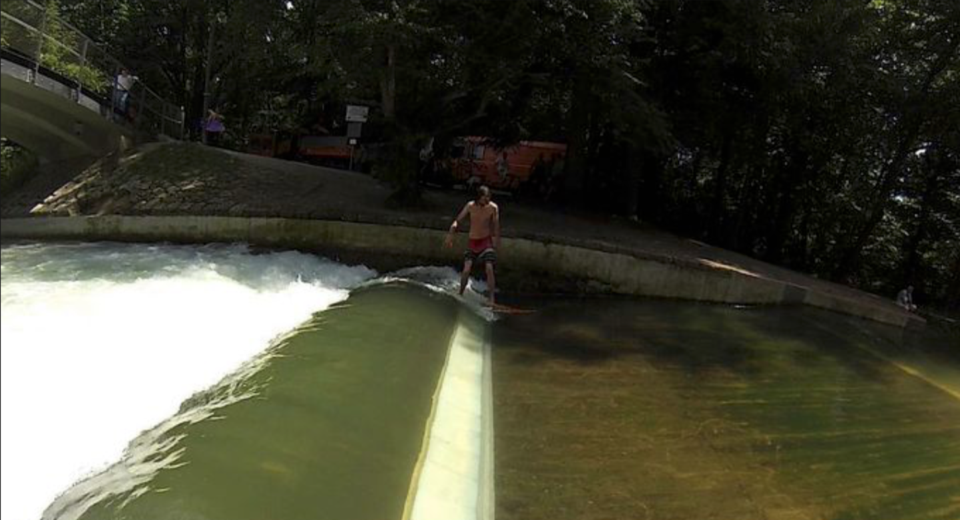
Floßlände
The Floßlände is a raft docking station located in the south of Munich.
https://surfersmag.de/news/national/die-flosslaende-laeuft-wieder.html

Slide 10
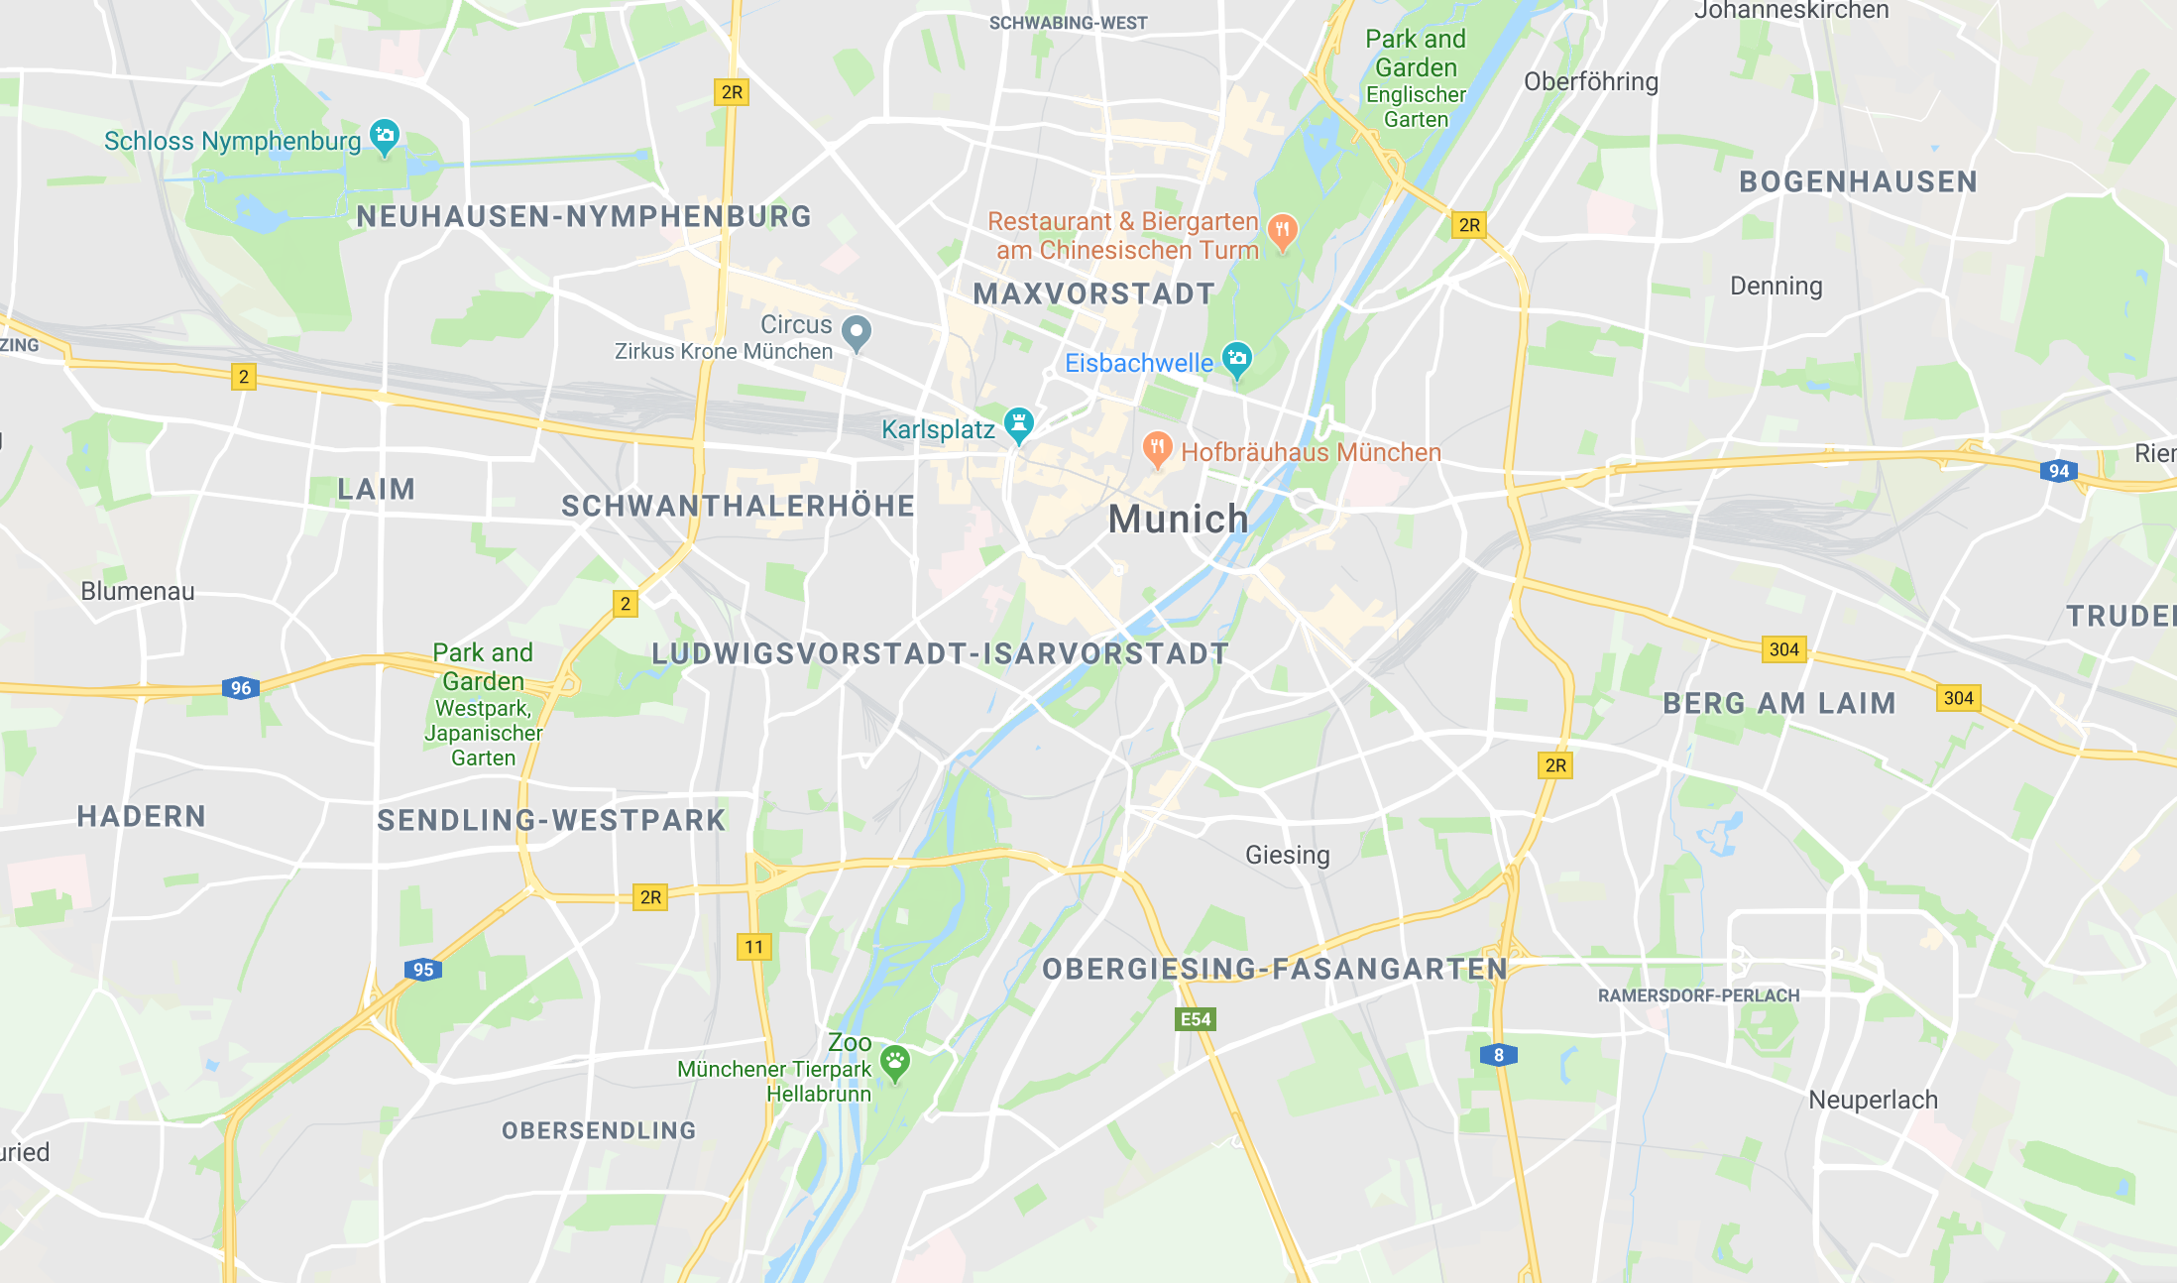
Floßlände
The Floßlände is a raft docking station located in the south of Munich.
Floßlände
https://surfersmag.de/news/national/die-flosslaende-laeuft-wieder.html

Slide 11
Floßlände
The Floßlände is a raft docking station located in the south of Munich.
One of three locations for river-surfing in Munich
Kleine Eisbachwelle
Eisbachwelle
Floßlände
https://www.google.com/maps/@48.1296319,11.5689836,13.38z
https://surfersmag.de/news/national/die-flosslaende-laeuft-wieder.html

Slide 12
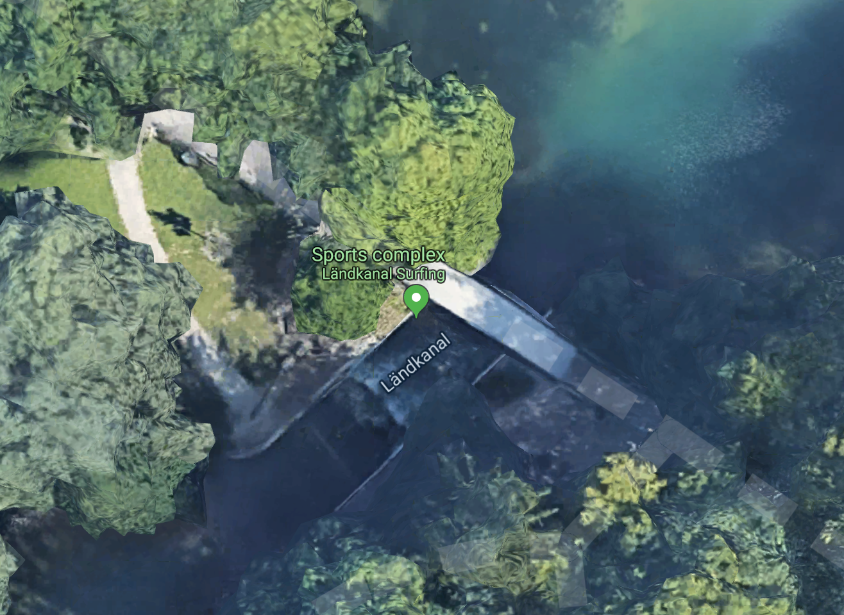
Floßlände
https://www.google.com/maps/place/Floßlände/@48.0902849,11.5451124,90m/data=!3m1!1e3!4m5!3m4!1s0x479dded9871220d9:0xf5c9512c03d35064!8m2!3d48.0922871!4d11.546413
Floßlände
https://www.google.com/maps/@48.1296319,11.5689836,13.38z
https://surfersmag.de/news/national/die-flosslaende-laeuft-wieder.html

Slide 13
Floßlände
https://surfersmag.de/news/national/die-flosslaende-laeuft-wieder.html

Slide 14
OpenFOAM
Open Source Field Operation and Manipulation
open source CFD – software (C++)
created in 2004 by OpenCFD ltd.
resolves complex problems:
Fluid flows (including turbulence, chemical reactions, heat transfer)
Solid mechanics
Acoustics
Electromagnetics
CFD is Awesome

Slide 15

interFoam
multiphase flow solver
incompressible, isothermal, immiscible
Volume of Fluid Method (VoF):
introduces the variable $α$
$0 ≤ α ≤1$
CFD is Awesome

Slide 16



interFoam
multiphase flow solver
incompressible, isothermal, immiscible
Volume of Fluid Method (VoF):
introduces the variable $α$
$0 ≤ α ≤1$
air
$$α=0$$
water
air
$$α=0.6$$
water
$$α=1$$
CFD is Awesome

Slide 17





interFoam – Equations
$$\frac{∂u_{j}}{∂x_{j}}=0$$
Continuity equation (incompressible)
$$\frac{\left.∂(ρu_{i}\right)}{∂t}+\frac{∂}{∂x_{j}}\left(ρu_{j}u_{i}\right)=−\frac{∂p}{∂x_{i}}+\frac{∂}{∂x_{j}}\left({τ_{v}}_{ij}+τ_{t_{ij}}\right)+ρg+f_{σi}$$
Momentum Equation
$$ρ=αρ_{1}+(1−α)ρ_{2}$$
Density Equation for VoF
$$\frac{∂α}{∂t}+\frac{\left.∂(αu_{j}\right)}{∂x_{j}}=0$$
Transport Equation for $α$
CFD is Awesome

Slide 18

shallowFoam
newly developed solver
2D
solves for shallow water flows
$h<<L$
CFD is Awesome

Slide 19






shallowFoam – Equations
$$\frac{∂u}{∂x}+\frac{∂v}{∂y}=0$$
Continuity equation for 2D incompressible flow
$$\frac{∂p}{∂z}=ρg → p\left(z\right)=ρg(z_{w}−z)+p_{a}$$
Vertical component of Momentum Equation
$$φ=\overline{φ}+\tilde{φ}$$
Depth average and deviatoric component
$$\overline{φ}=\frac{1}{h}\int_{z_{b}}^{z_{w}}{\overline{φ} dz}$$
Definition of depth average component
$$\frac{∂h}{∂t}+\frac{∂q_{i}}{∂x_{i}}=0$$
Depth averaged transport equation
$$\frac{∂q_{i}}{∂t}+\overline{u_{j}}\frac{∂q_{i}}{∂x_{j}}=−\frac{g}{2} \frac{∂h^{2}}{∂x_{i}}−gh\frac{∂z_{b}}{∂x_{i}}−\frac{τ_{bi}}{ρ}+\frac{1}{ρ}\frac{∂h\overline{τ_{ij}}}{∂x_{j}}$$
Depth averaged momentum equation
CFD is Awesome

Slide 20
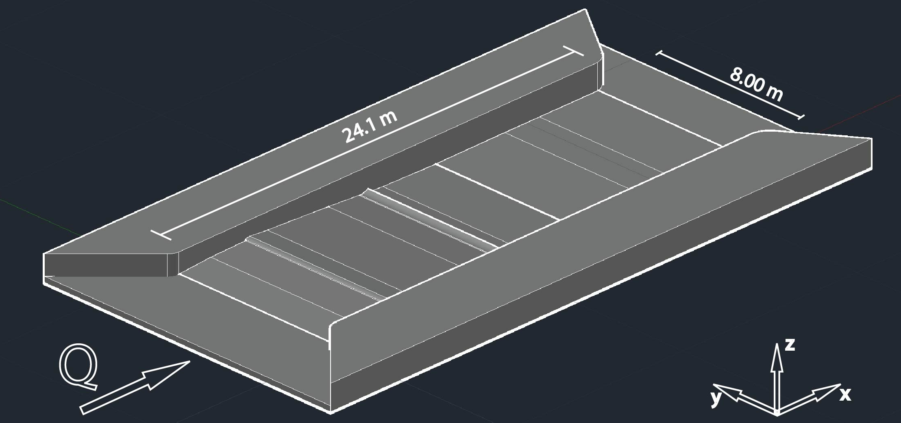
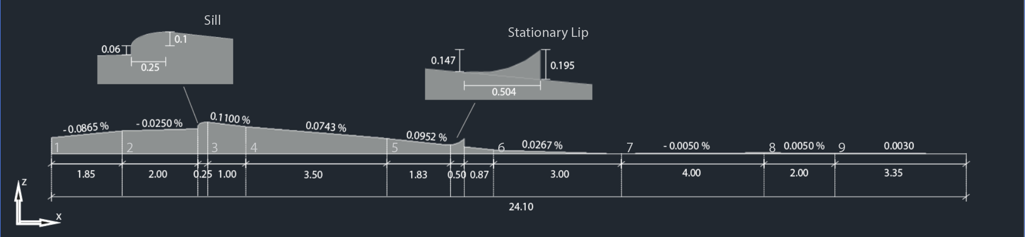
Geometry
524.20 m.a.s.l.
523.82 m.a.s.l.
CFD is Awesome

Slide 21
Geometry
Mesh will represent one strip of the channel
524.20 m.a.s.l.
523.82 m.a.s.l.
CFD is Awesome

Slide 22
Geometry
Mesh will represent one strip of the channel
Origin of coordinate system
524.20 m.a.s.l.
523.82 m.a.s.l.
CFD is Awesome

Slide 23
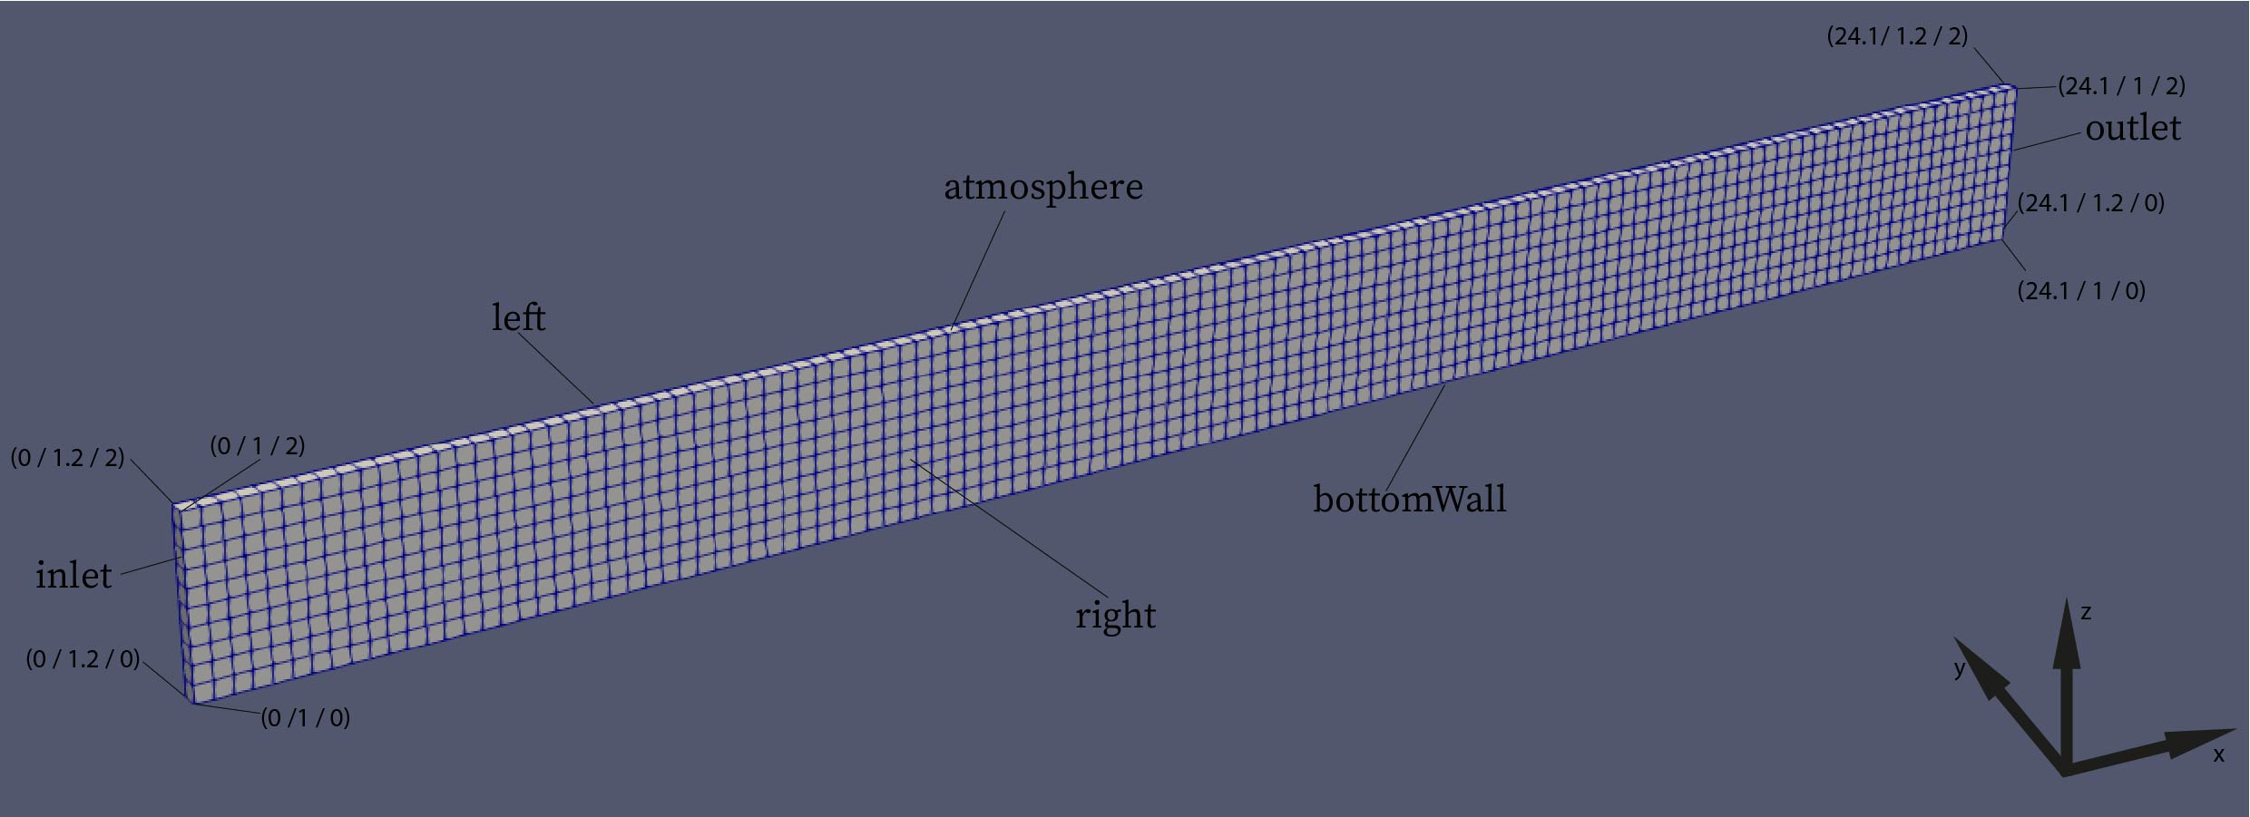
3D mesh
blockMesh
1200 cells instead of 48000
CFD is Awesome

Slide 24
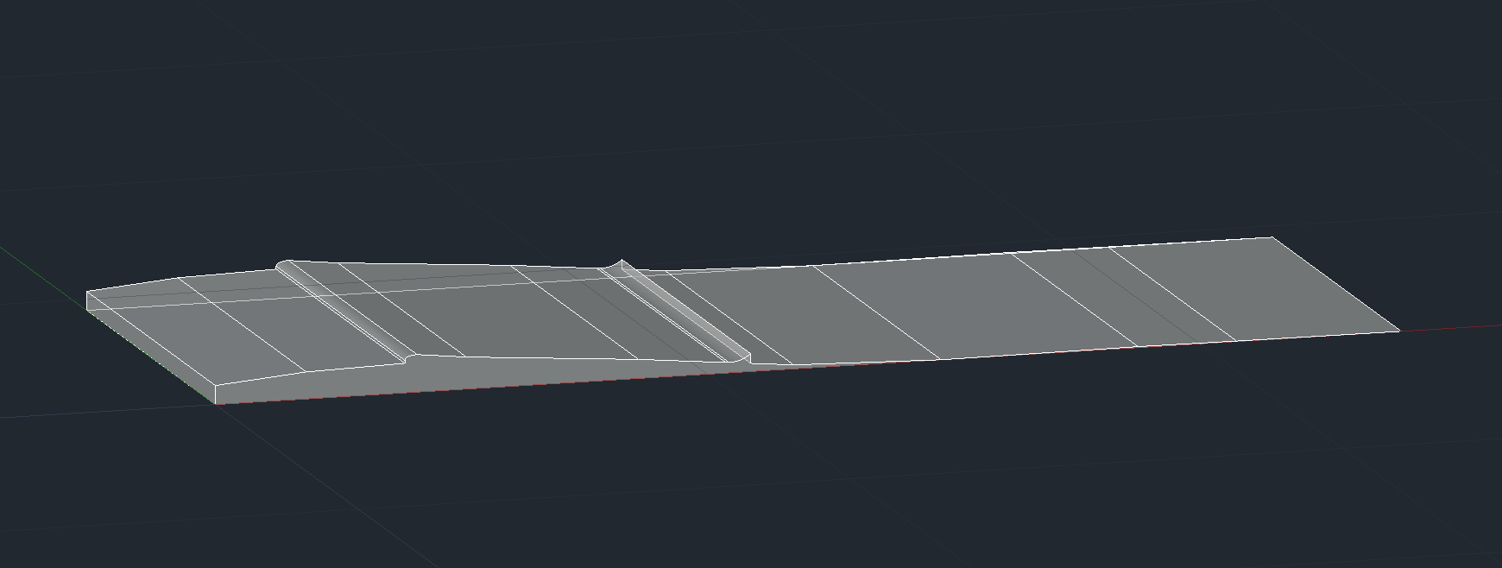
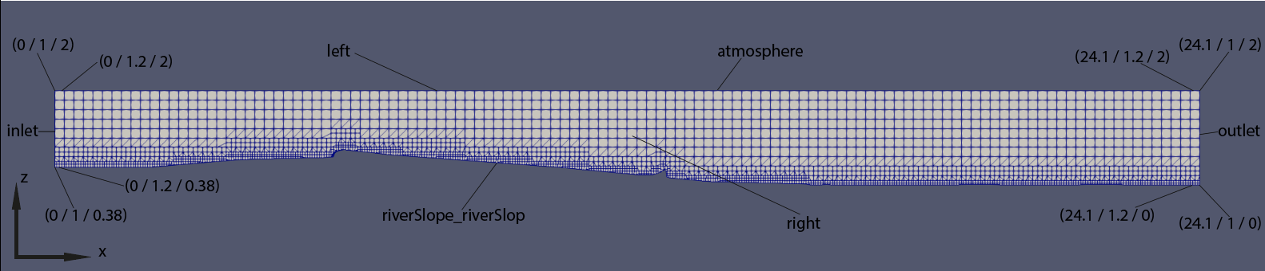
3D mesh
snappyHexMesh
_
=
e
CFD is Awesome

Slide 25
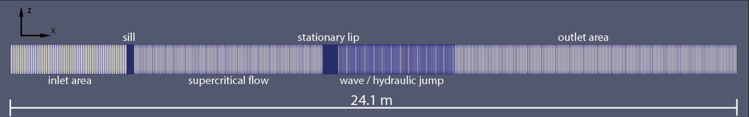
2D mesh
blockMesh
CFD is Awesome

Slide 26



3D simulation
Prototype simulation with $Q=8.003\frac{m^{3}}{s}$ based on data from physical model
Inlet flow depth:
Inlet location of interface:
$$h=1.0168 m$$
$$z_{w}=1.3968 m$$
Inlet velocity:
$$u_{x}=\frac{Q}{b∗h}=\frac{8.003{{ m}^{3}}/s}{8 m∗1.0168 m}≈0.9839 m/s$$
CFD is Awesome

Slide 27

3D simulation – initial conditions
funkySetFields
$α$:
((pos().x <= 4.1 && pos().z < 1.3968) || (pos().x > 4.1 && pos().x <= 12 && …
pos().z < 1.3968 - (pos().x - 4.1) * 0.09) || (pos().x > 12 && pos().z < 0.75) ? 1 : 0)
velocity:
alpha1 == 1 ? vector(0.9839,0,0) : vector(0,0,0)
CFD is Awesome

Slide 28
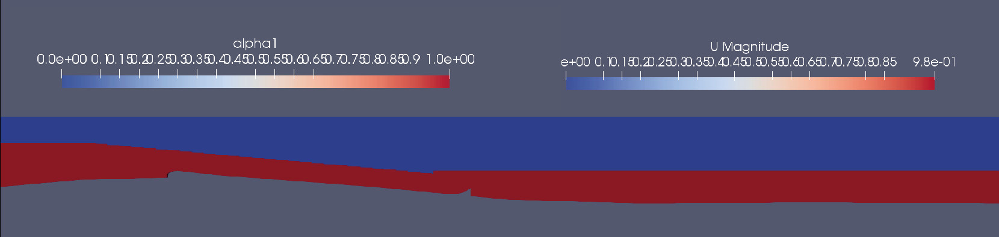
3D simulation – initial conditions
CFD is Awesome

Slide 29
3D simulation – boundary conditions
funkySetBoundary
$α$:
velocity:
pos().z < 1.3968 ? 1 : 0
alpha1 == 1 ? vector(0.9839,0,0) : vector(0,0,0)
PATCH | BOUNDARY CONDITION
outlet | zeroGradient
atmosphere | uniform 0
Left | slip
right | slip
riverSlope_riverSlope | uniform 1
Boundary patch | Boundary condition
outlet | zeroGradient
atmosphere | uniform 0
Left | slip
right | slip
riverSlope_riverSlope | uniform 0
CFD is Awesome

Slide 30
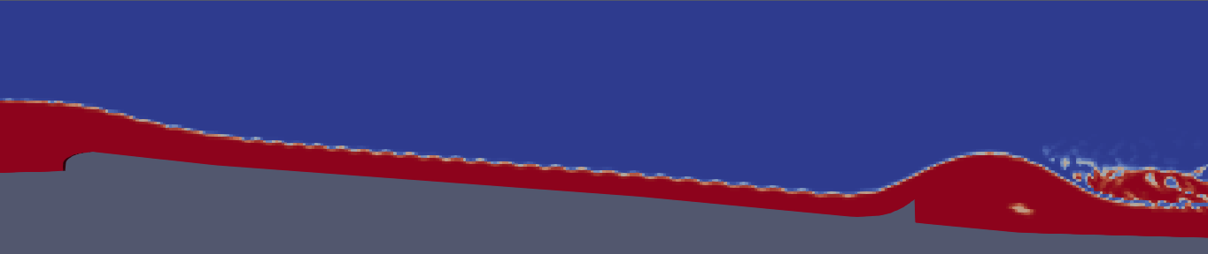
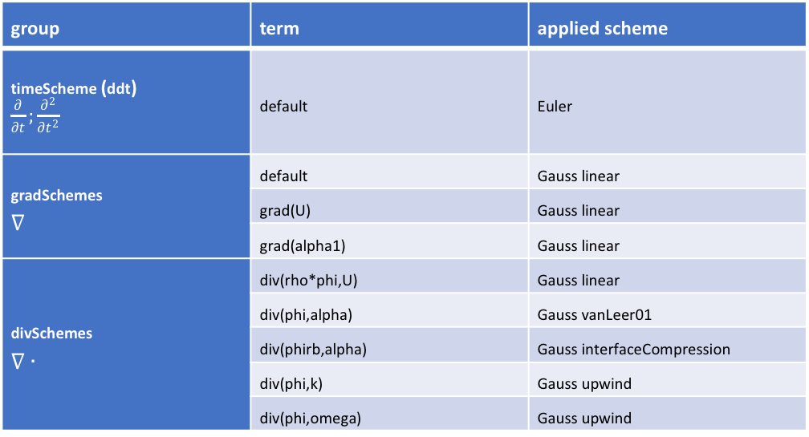
3D simulation – numerics
group | term | applied scheme
timeScheme (ddt) $\frac{∂}{∂t};\frac{∂^{2}}{∂t^{2}}$ | default | Euler
gradSchemes $∇$ | default | Gauss linear
 | grad(U) | Gauss linear
 | grad(alpha1) | Gauss linear
divSchemes $∇∙$ | div(rho*phi,U) | Gauss linear
 | div(phi,alpha) | Gauss vanLeer01
 | div(phirb,alpha) | Gauss interfaceCompression
 | div(phi,k) | Gauss upwind
 | div(phi,omega) | Gauss upwind
CFD is Awesome

Slide 31
3D simulation – numerics
group | term | applied scheme
timeScheme (ddt) $\frac{∂}{∂t};\frac{∂^{2}}{∂t^{2}}$ | default | Euler
gradSchemes $∇$ | default | Gauss linear
 | grad(U) | Gauss linear
 | grad(alpha1) | Gauss linear
divSchemes $∇∙$ | div(rho*phi,U) | Gauss linear
 | div(phi,alpha) | Gauss vanLeer01
 | div(phirb,alpha) | Gauss interfaceCompression
 | div(phi,k) | Gauss upwind
 | div(phi,omega) | Gauss upwind
CFD is Awesome

Slide 32
3D simulation – numerics
group | term | applied scheme
timeScheme (ddt) $\frac{∂}{∂t};\frac{∂^{2}}{∂t^{2}}$ | default | Euler
gradSchemes $∇$ | default | Gauss linear
 | grad(U) | Gauss linear
 | grad(alpha1) | Gauss linear
divSchemes $∇∙$ | div(rho*phi,U) | Gauss linear
 | div(phi,alpha) | Gauss vanLeer01
 | div(phirb,alpha) | Gauss interfaceCompression
 | div(phi,k) | Gauss upwind
 | div(phi,omega) | Gauss upwind
CFD is Awesome

Slide 33
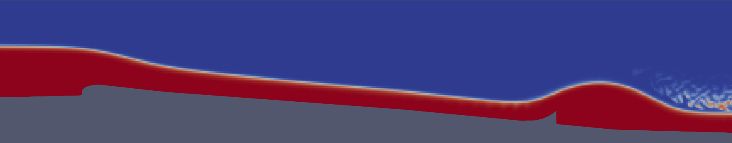
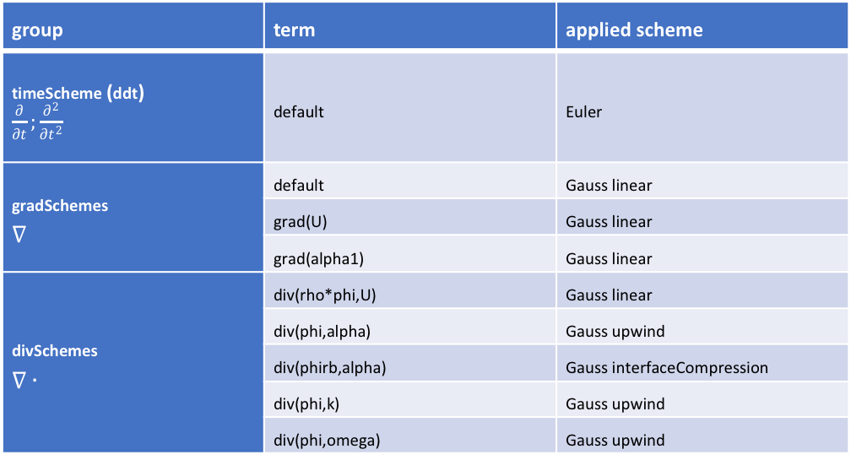
3D simulation – numerics
group | term | applied scheme
timeScheme (ddt) $\frac{∂}{∂t};\frac{∂^{2}}{∂t^{2}}$ | default | Euler
gradSchemes $∇$ | default | Gauss linear
 | grad(U) | Gauss linear
 | grad(alpha1) | Gauss linear
divSchemes $∇∙$ | div(rho*phi,U) | Gauss linear
 | div(phi,alpha) | Gauss upwind
 | div(phirb,alpha) | Gauss interfaceCompression
 | div(phi,k) | Gauss upwind
 | div(phi,omega) | Gauss upwind
CFD is Awesome

Slide 34
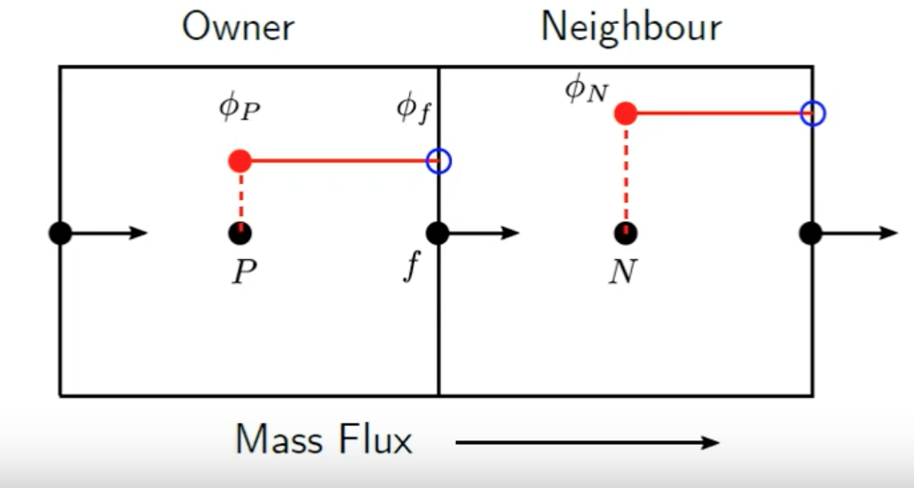
3D simulation – numerics
group | term | applied scheme
timeScheme (ddt) $\frac{∂}{∂t};\frac{∂^{2}}{∂t^{2}}$ | default | Euler
gradSchemes $∇$ | default | Gauss linear
 | grad(U) | Gauss linear
 | grad(alpha1) | Gauss linear
divSchemes $∇∙$ | div(rho*phi,U) | Gauss linear
 | div(phi,alpha) | Gauss upwind
 | div(phirb,alpha) | Gauss interfaceCompression
 | div(phi,k) | Gauss upwind
 | div(phi,omega) | Gauss upwind
CFD is Awesome

Slide 35
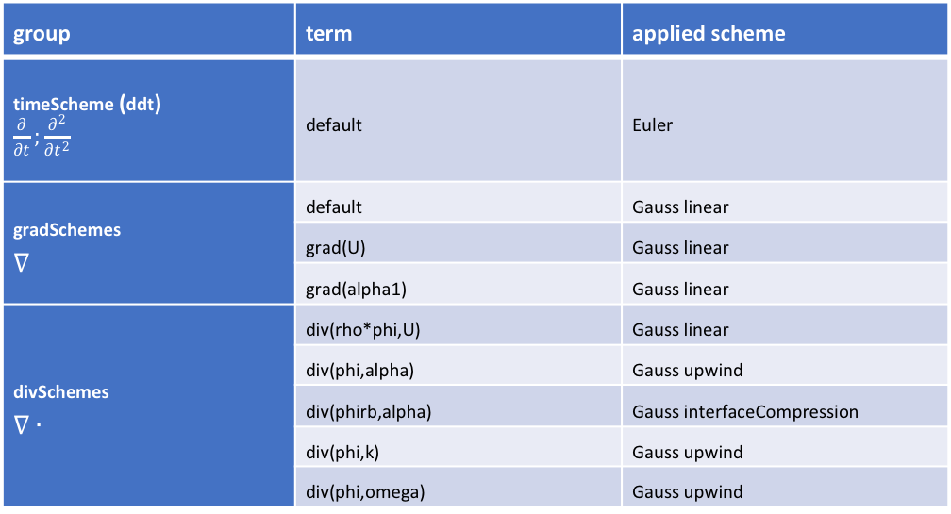
3D simulation – numerics
group | term | applied scheme
timeScheme (ddt) $\frac{∂}{∂t};\frac{∂^{2}}{∂t^{2}}$ | default | Euler
gradSchemes $∇$ | default | Gauss linear
 | grad(U) | Gauss linear
 | grad(alpha1) | Gauss linear
divSchemes $∇∙$ | div(rho*phi,U) | Gauss linear
 | div(phi,alpha) | Gauss upwind
 | div(phirb,alpha) | Gauss interfaceCompression
 | div(phi,k) | Gauss upwind
 | div(phi,omega) | Gauss upwind
CFD is Awesome

Slide 36
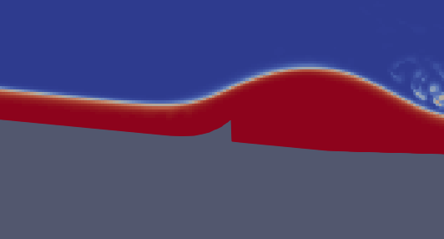

3D simulation – numerics
Lowering the tolerance of pd and pdFinal from
${10}^{−7}$ to ${10}^{−9}$
CFD is Awesome

Slide 37
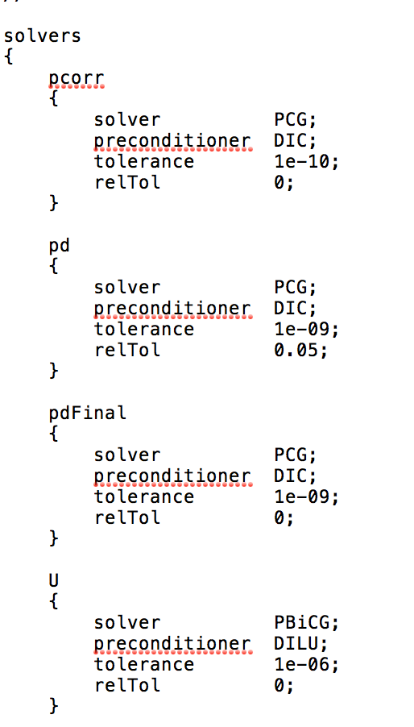
3D simulation – numerics
Lowering the tolerance of pd and pdFinal from
${10}^{−7}$ to ${10}^{−9}$
CFD is Awesome

Slide 38
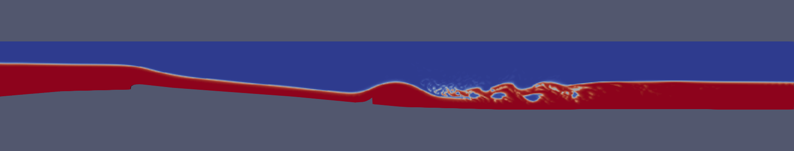
3D simulation – numerics
CFD is Awesome

Slide 39
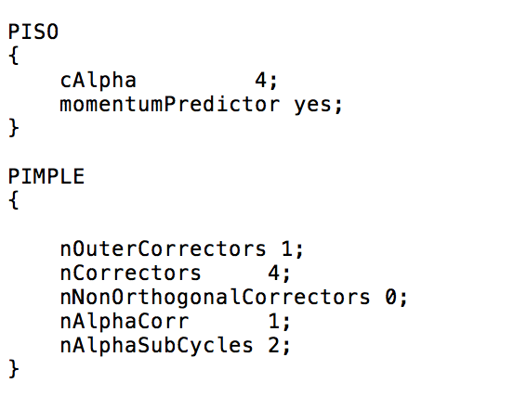


3D simulation – numerics
cAlpha $=1$
$=0 → no interface compression$
cAlpha $=1 → conservatinve compression$
$>1 → increased compression$
CFD is Awesome

Slide 40
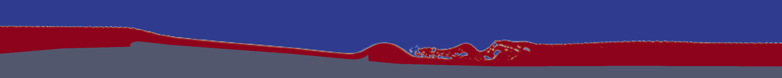

3D simulation – numerics
cAlpha $=1$
cAlpha $=4$
CFD is Awesome

Slide 41
3D simulation – numerics
cAlpha $=1$
cAlpha $=4$
CFD is Awesome

Slide 42

3D simulation – numerics
cAlpha $=4$
CFD is Awesome

Slide 43
3D simulation – numerics
cAlpha $=4$
The wiggles have moved from the supercritical flow to the subcritical flow
CFD is Awesome

Slide 44
3D simulation – turbulence
k-omegaSST
k-epsilon
CFD is Awesome

Slide 45
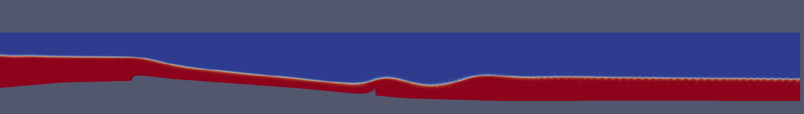
3D simulation – turbulence
k-omegaSST
k-epsilon
CFD is Awesome

Slide 46
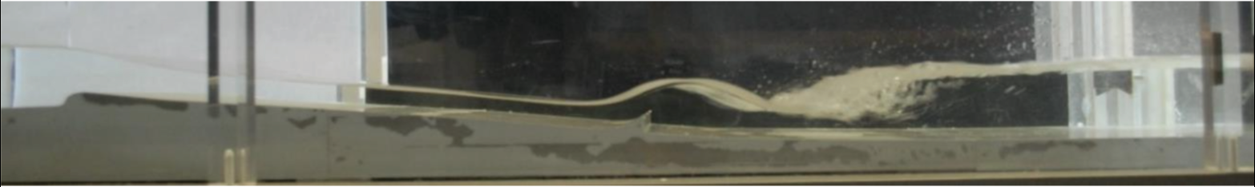
3D simulation – turbulence
k-omegaSST
k-epsilon
Morandi, R. (2018). Maßstäbliche Untersuchung zur stationären Welle an der Floßlände. Bachelor. Technical University of Munich.
CFD is Awesome

Slide 47
3D simulation – turbulence
k-omegaSST
k-epsilon
Morandi, R. (2018). Maßstäbliche Untersuchung zur stationären Welle an der Floßlände. Bachelor. Technical University of Munich.
CFD is Awesome

Slide 48
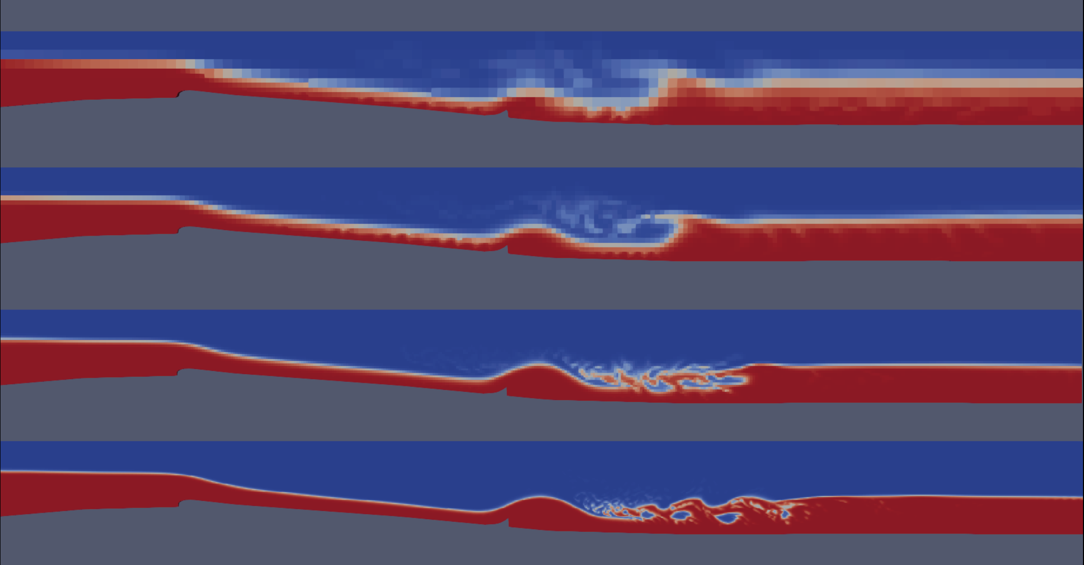
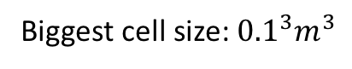
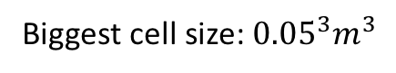
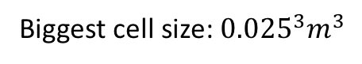
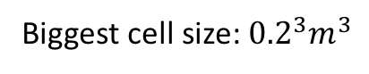
3D simulation – mesh convergence
6910 cells
Biggest cell size: ${0.2}^{3}m^{3}$
16709 cells
Biggest cell size: ${0.1}^{3}m^{3}$
42027 cells
Biggest cell size: ${0.05}^{3}m^{3}$
119952 cells
Biggest cell size: ${0.025}^{3}m^{3}$
CFD is Awesome

Slide 49
3D simulation – mesh convergence
( x / z )
6910 cells
Biggest cell size: ${0.2}^{3}m^{3}$
( x / z )
16709 cells
Biggest cell size: ${0.1}^{3}m^{3}$
( x / z )
42027 cells
Biggest cell size: ${0.05}^{3}m^{3}$
( x / z )
119952 cells
Biggest cell size: ${0.025}^{3}m^{3}$
CFD is Awesome

Slide 50
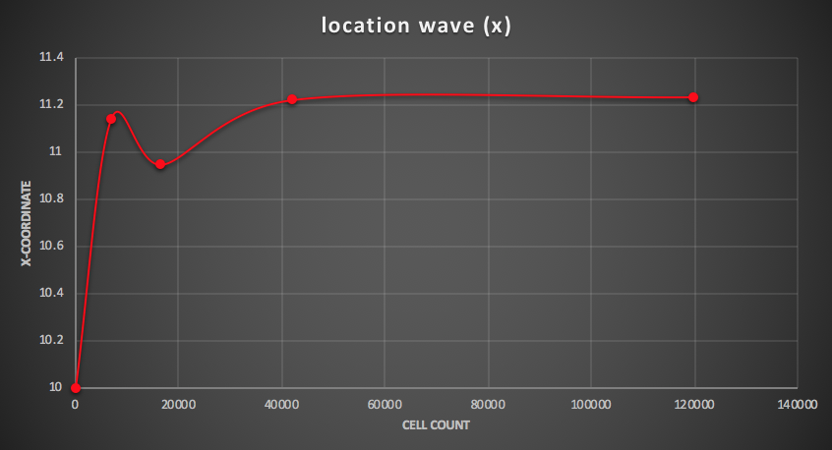
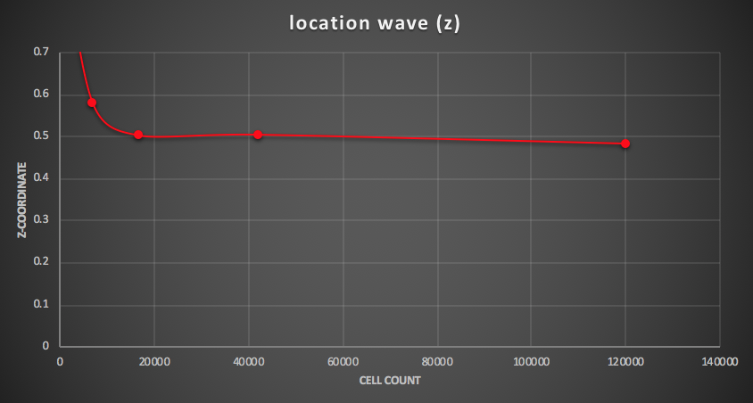
3D simulation – mesh convergence
CFD is Awesome

Slide 51




2D simulation
Prototype simulation with $Q=5\frac{m^{3}}{s}$
Inlet flow depth:
Inlet location of interface:
$$h=0.85 m$$
$$z_{w}=1.23 m$$
Specific discharge at inlet:
$q=\frac{5\frac{m^{3}}{s}}{8 m}=0.625\frac{m^{2}}{s}$
CFD is Awesome

Slide 52

2D simulation – initial conditions
funkySetFields
$z_{w}$:
(pos().x <= 4.1) ? (1.23) : ((pos().x > 4.1) && …
(pos().x < 11) ? (1.23 - (pos().x - 4.1) * 0.09) : ((pos().x >= 11) ? (0.65)))
CFD is Awesome

Slide 53

2D simulation – initial conditions
funkySetFields
$z_{w}$:
(pos().x <= 4.1) ? (1.23) : ((pos().x > 4.1) && …
(pos().x < 11) ? (1.23 - (pos().x - 4.1) * 0.09) : ((pos().x >= 11) ? (0.65)))
$$u=\frac{q}{z_{w}−z_{b}}$$
CFD is Awesome

Slide 54
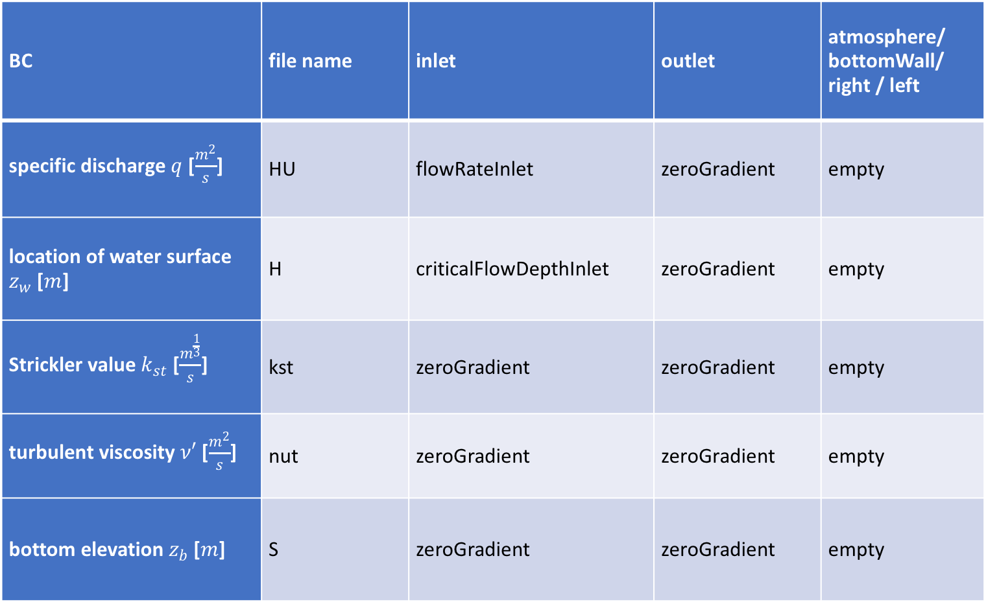
2D simulation – boundary conditions
BC | file name | inlet | outlet | atmosphere/ bottomWall/ right / left
specific discharge $q$ [$\frac{m^{2}}{s}$] | HU | flowRateInlet | zeroGradient | empty
location of water surface $z_{w}$ [$m$] | H | criticalFlowDepthInlet | zeroGradient | empty
Strickler value $k_{st}$ [$\frac{m^{\frac{1}{3}}}{s}$] | kst | zeroGradient | zeroGradient | empty
turbulent viscosity $ν′$ [$\frac{m^{2}}{s}$] | nut | zeroGradient | zeroGradient | empty
bottom elevation $z_{b}$ [$m$] | S | zeroGradient | zeroGradient | empty
CFD is Awesome

Slide 55
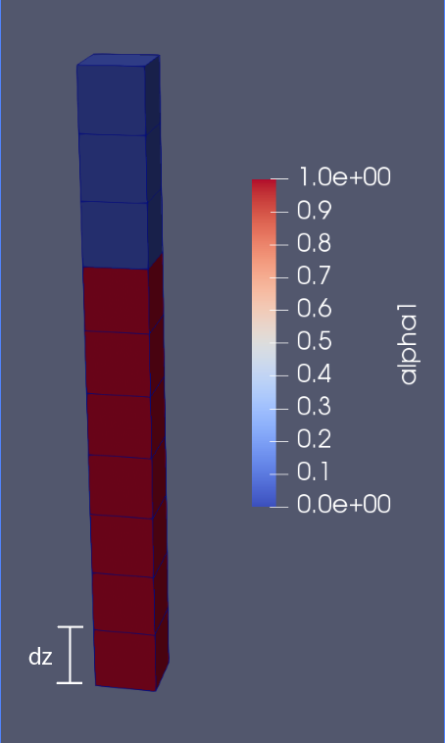


Results – 3D
$$z_{w}\left(x\right)=M−\sum_{i=1}^{n}{\left({1−α}_{i}\left(x\right)\right)∗dz}$$
$M=2 →$ mesh height
$$\left.h\left(x\right)=z_{w}\left(x\right)−z_{b}(x\right)$$
CFD is Awesome

Slide 56
Results – 3D
$$z_{w}\left(x\right)=M−\sum_{i=1}^{n}{\left({1−α}_{i}\left(x\right)\right)∗dz}$$
$M=2 →$ mesh height
$$\left.h\left(x\right)=z_{w}\left(x\right)−z_{b}(x\right)$$
e
CFD is Awesome

Slide 57
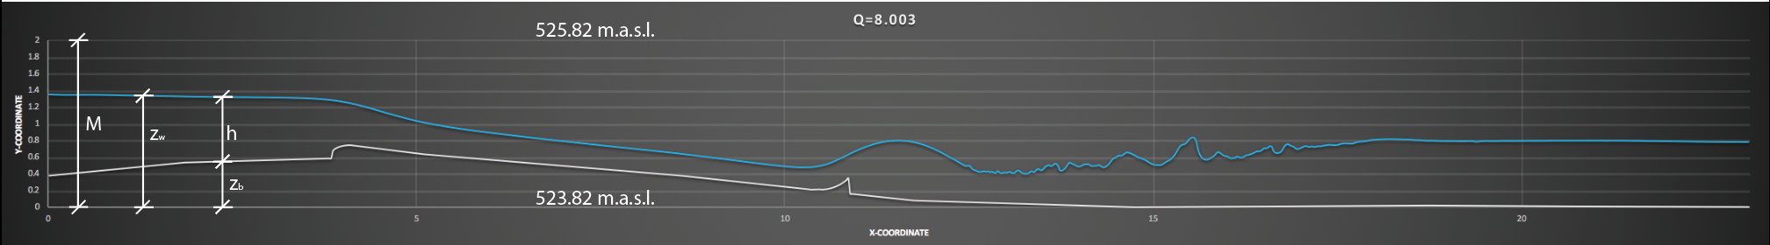
Results – 3D
$$z_{w}\left(x\right)=M−\sum_{i=1}^{n}{\left({1−α}_{i}\left(x\right)\right)∗dz}$$
$M=2 →$ mesh height
$$\left.h\left(x\right)=z_{w}\left(x\right)−z_{b}(x\right)$$
CFD is Awesome

Slide 58
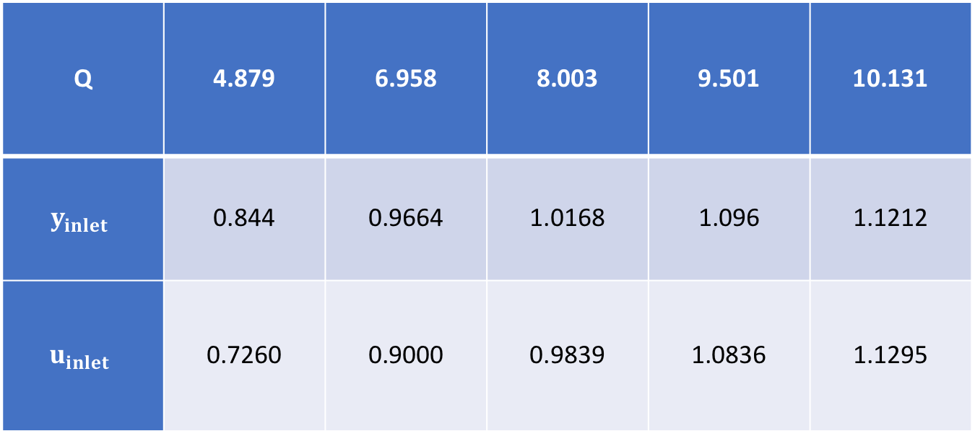
Results – 3D
5 discharges matching the physical model
Q | 4.879 | 6.958 | 8.003 | 9.501 | 10.131
$$y_{inlet}$$ | 0.844 | 0.9664 | 1.0168 | 1.096 | 1.1212
$$u_{inlet}$$ | 0.7260 | 0.9000 | 0.9839 | 1.0836 | 1.1295
CFD is Awesome

Slide 59
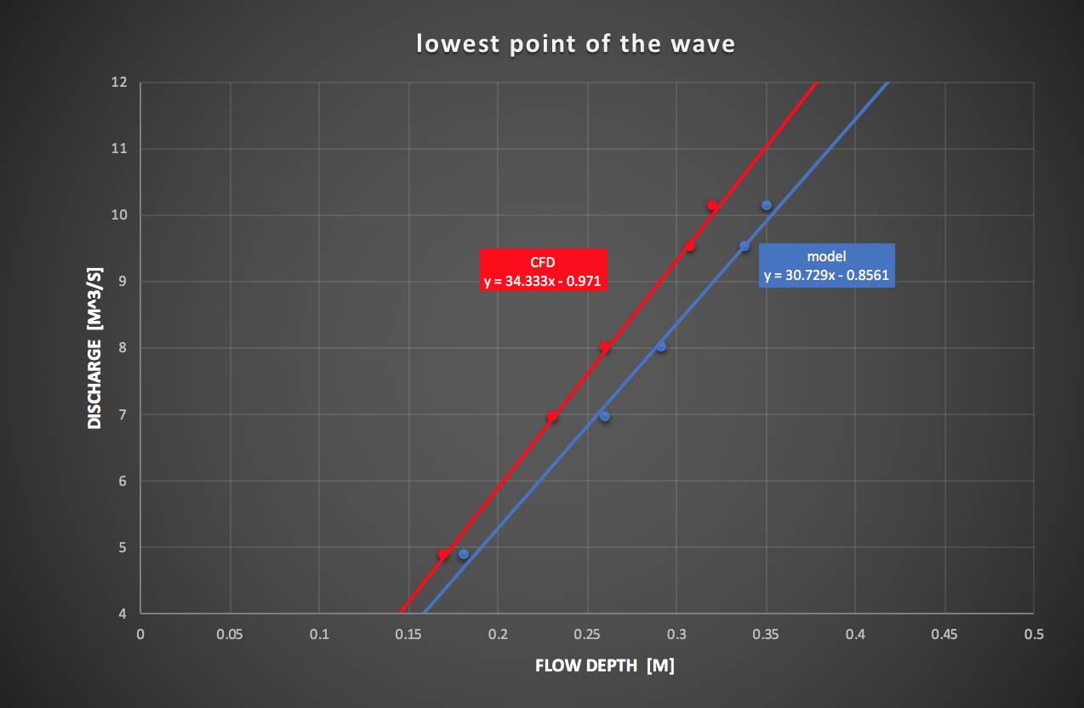
Results – 3D
CFD is Awesome

Slide 60
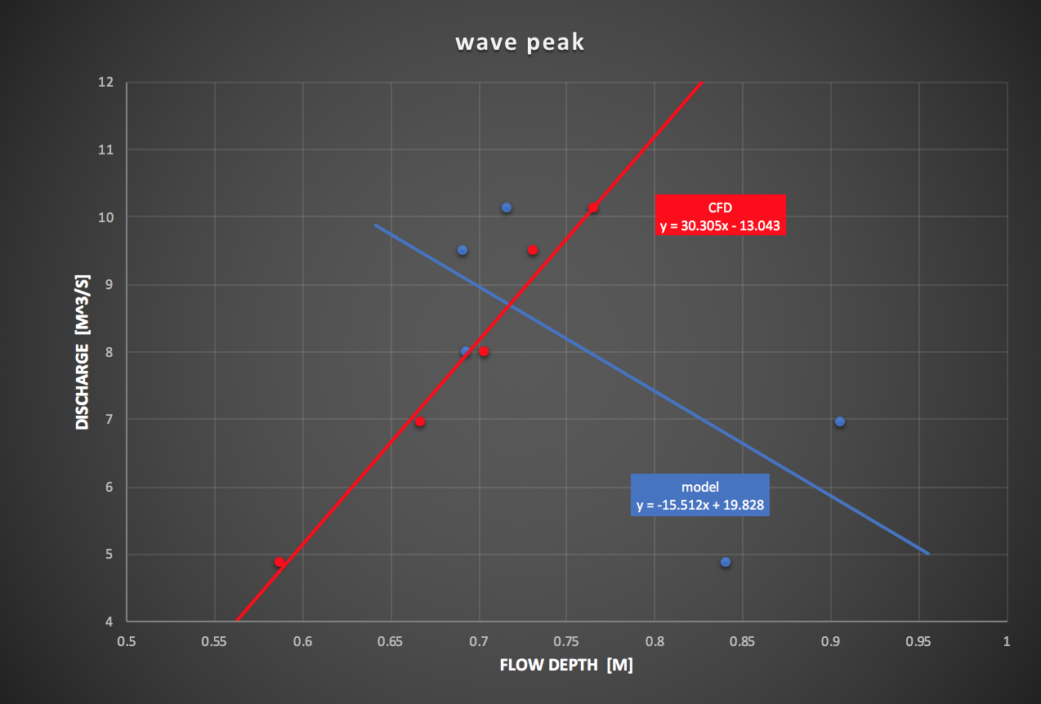
Results – 3D
CFD is Awesome

Slide 61
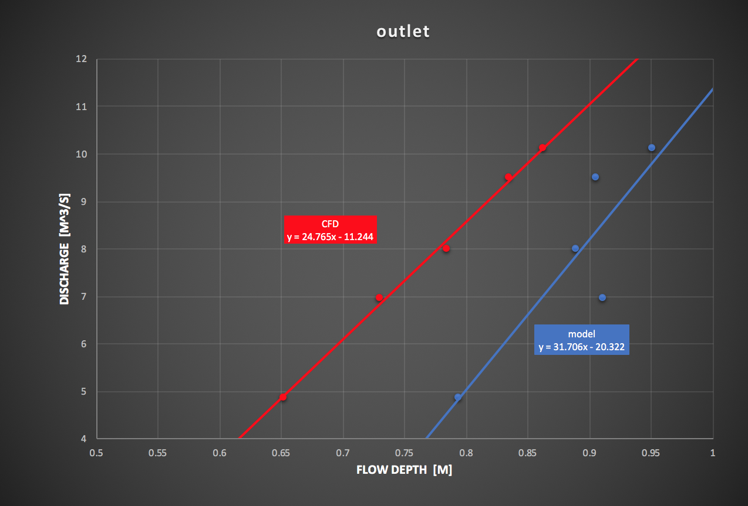
Results – 3D
CFD is Awesome

Slide 62


Results – 3D
$$H\left(x\right)=z_{b}\left(x\right)+h\left(x\right)+\frac{\left.U^{2}(x\right)}{2g}$$
$$U(x)=\frac{\sum_{i=1}^{n}{α_{i}∗\sqrt{\left.{u_{xi}}^{2}(x){+u_{zi}}^{2}(x\right)}}}{\left.h(x\right)}∗dz$$
CFD is Awesome

Slide 63
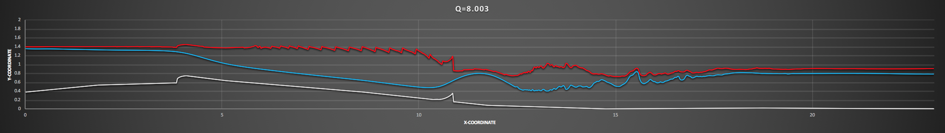
Results – 3D
$$H\left(x\right)=z_{b}\left(x\right)+h\left(x\right)+\frac{\left.U^{2}(x\right)}{2g}$$
$$U(x)=\frac{\sum_{i=1}^{n}{α_{i}∗\sqrt{\left.{u_{xi}}^{2}(x){+u_{zi}}^{2}(x\right)}}}{\left.h(x\right)}∗dz$$
CFD is Awesome

Slide 64
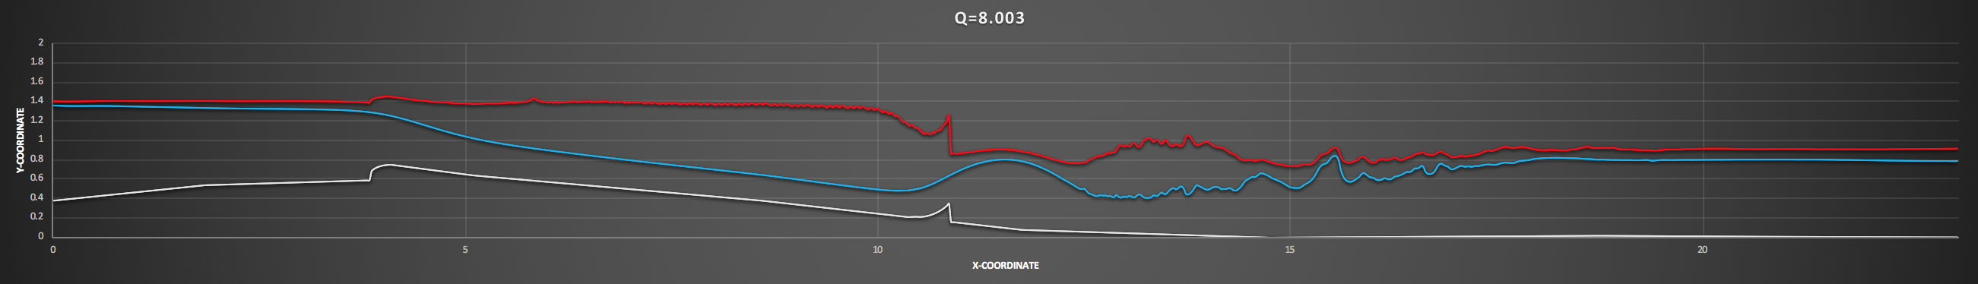
Results – 3D
$$H\left(x\right)=z_{b}\left(x\right)+h\left(x\right)+\frac{\left.U^{2}(x\right)}{2g}$$
$$U(x)=\frac{\sum_{i=1}^{n}{α_{i}∗\sqrt{\left.{u_{xi}}^{2}(x){+u_{zi}}^{2}(x\right)}}}{\left.h(x\right)}∗dz$$
CFD is Awesome

Slide 65
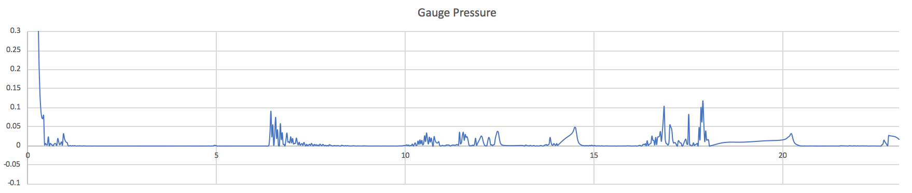
Results – 3D
CFD is Awesome

Slide 66


Results – 2D
${(z}_{w}$)
CFD is Awesome

Slide 67

Results – 2D
${(z}_{w}$)
CFD is Awesome

Slide 68
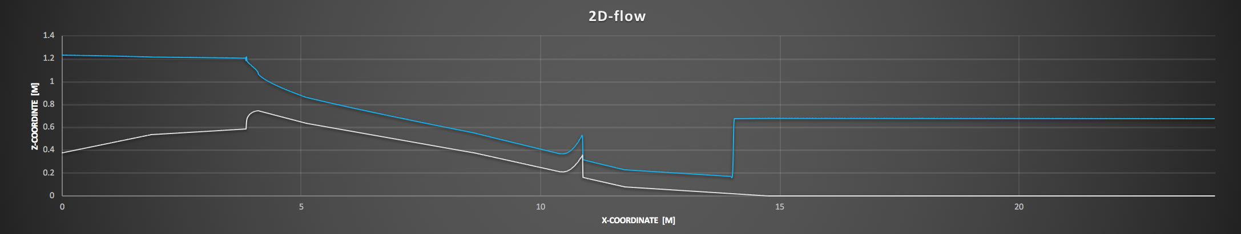
Results – 2D
CFD is Awesome

Slide 69
Results – 2D
CFD is Awesome

Slide 70
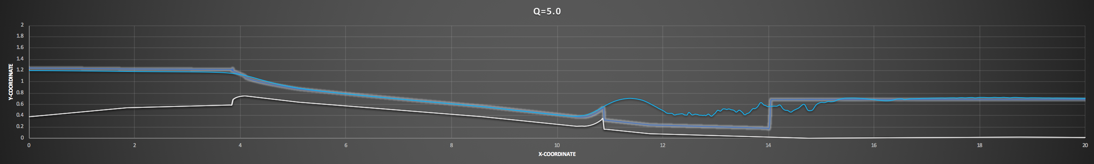
Results – 2D
CFD is Awesome

Slide 71
Results – 2D
CFD is Awesome

Slide 72
Results – 2D
CFD is Awesome

Slide 73
Results – 2D
CFD is Awesome

Slide 74
Results – 2D
CFD is Awesome

Slide 75
Conclusion
The way to go is coupling 2D and 3D to shallowInterFoam developed by Dr. Florian Mintgen
CFD is Awesome

Slide 76
But in the end it all about surfing
CFD is Awesome

